Slide 1
DevOps
CI/CD

Slide 2
What is DevOps
DevOps is a culture which promotes collaboration between Development and Operations Team to deploy code to production faster in an automated & repeatable way.
The word 'DevOps' is a combination of two words 'development' and 'operations.'

Slide 3
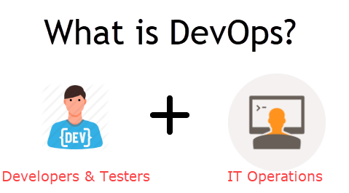
DevOps
An alignment of development and IT operations with better communication and collaboration.

Slide 4
Advantages
Increase an Organization’s speed to deliver application and services.
Serve customer’s better
Compete more strongly in the market.

Slide 5
Why Devops?
Before DevOps:-
The development and operation team worked in complete isolation.
Testing and Deployment were isolated activities done after design-build. Hence they consumed more time than actual build cycles.
Team members are spending a large amount of their time in testing, deploying, and designing instead of building the project.
Manual code deployment leads to human errors in production
Coding & operation teams have their separate timelines and are not in synch causing further delays.

Slide 6
Why DevOps?
Predictability – Lower failure rates for new Releases
Reproducability – Earlier versions can be restored anytime
Maintainability -
Time to Market – streamlined software delivery
Quality -
Reduced Risk - Reduce defects
Resiliency – Changes are Auditable
Cost Efficiency -
Breaks Larger code base into small chunks – follows Agile methodology

Slide 7
When to Use and When Not to Use?
Use
Large Distributed Applications like Ecommerce
Applications hosted on Cloud Platform
NOT to Use
Mission Critical Applications like Bank, Power and other sensitive data sites.
These applications need:
Strict Access control on the production Environment
Detailed Change management policy
Access control policy to the data centres

Slide 8
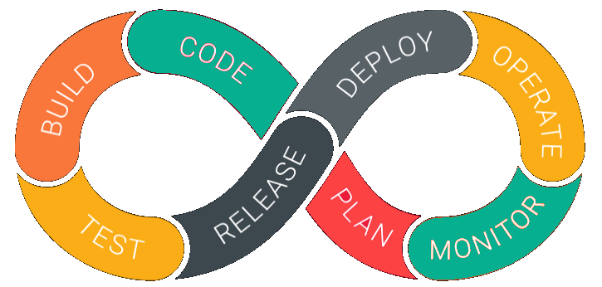
DevOps Lifecycle

Slide 9
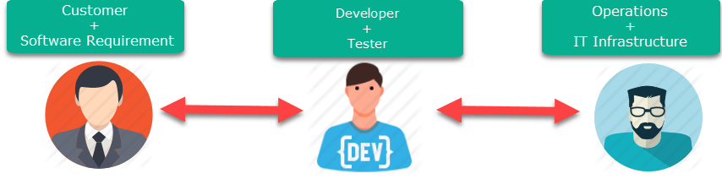
DevOps vs Agile
Agile
DevOps

Slide 10
DevOps Principles
Customer-Centric Action
End-To-End Responsibility
Continuous Improvement
Automate Everything
Work as one Team
Monitor and Test Everything

Slide 11
DevOps Automation Tools
Different categories of Automation:
Infrastructure Automation
AWS, Azure
Configuration Management
Chef, Puppet
Deployment Automation
Jenkins
Performance Management
App Dynamic
Log Management
Splunk
Monitoring.
Nagios

